Slide 1

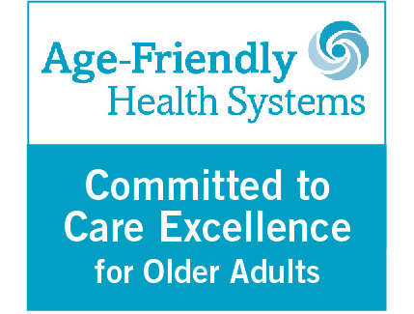
2025 Geriatrics Symposium:
Care Across the Continuum
Caring for Caregivers
Diane Mariani, LCSW
Notes:
RUSH is an Age-Friendly Health System which means that we reliably provide a set of four evidence-based elements of high-quality care, known as the “4Ms,” to all older adults in your system: What Matters, Medication, Mentation, and Mobility. As to quote Rani Snyder, VP Programs at The John A. Hartford Foundation “How can a health system truly be age-friendly if it doesn’t address caregivers?”

Slide 2

Rosalyn Carter quote
“There are only four kinds of people in the world.
Those who have been caregivers.
Those who are currently caregivers.
Those who will be caregivers
And those who will need a caregiver.”
Notes:
Rosalynn Carter: A Pioneering Caregiving Advocate Says More Must Be Done | Next Avenue
Most people do not plan to be a caregiver, 53% reported having no choice,
Unlike many other role changes, not clear when one becomes a caregiver,
May occur Acutely, in crisis, gradually, or in cycles

Slide 3
Defining a caregiver
The Recognize, Assist, Include, Support, and Engage (RAISE) Family Caregivers Act defines the term “family caregiver” as:
"an adult family member or other individual who has a significant relationship with, and who provides a broad range of assistance to, an individual with a chronic or other health condition, disability, or functional limitation"
Public Law 115-119. 115th Congress. January 2018. https://acl.gov/sites/default/files/about-acl/2018-10/PLAW-115publ119%20-%20RAISE.pdf

Slide 4
Common challenges for caregivers
  Caregivers have higher levels of stress than non-caregivers and caregivers with chronic stress may be at greater risk of cognitive decline
  Causes include:
    Managing multiple roles
    Adapting to new roles (complex medical, domestic)
    Isolation
    Physical demands
Vitaliano, P.P., Echeverria, D., Yi, J., Phillips, P.E.M, Young, H. & Siegler, I.C.. (2005). Psychophysiological mediators of caregiver stress and differential cognitive decline. Psychology and Aging, 20, 402-411. DOI: 10.1037/0882 7974.210.1037/0882-7974.20.3.4020.3.402.

Slide 5
Common challenges for caregivers
  Clinically significant signs of depressive disorder are present in 40%-70% of family caregivers of older adults, with a quarter to a half of them meeting criteria for major depression
  40% report experiencing two or more chronic diseases
Zarit, S. (2006). Assessment of Family Caregivers: A Research Perspective. In Family Caregiver Alliance (Eds.), Caregiver Assessment: Voices and Views from the Field. Report from a National Consensus Development Conference (Vol. II) (pp. 12 – 37). San Francisco: Family Caregiver Alliance.

Slide 6
Common challenges for caregivers
  About 58% of caregivers engage in medical and nursing tasks
  Administering medications
  Wound care
  Handling complex medical equipment in the home
  Despite this, caregivers are rarely asked “are you ready, willing, and able to provide this care?
https://www.aarp.org/pri/topics/ltss/family-caregiving/caregiving-in-the-us-2025/?msockid=34966bddefa3610f3ba47de5eedd602c

Slide 7
Caregiving as a Social Determinant of Health
Recent studies have examined how integration of social determinants of health in risk assessment, health care utilization, and health outcomes improves the potential to reduce health care disparities
Caregiving should be considered a social determinant of health
More research is needed that addresses the diversity both in caregiver populations and in caregiver needs.
Bakken S. Toward diversity, equity, and inclusion in informatics, health care, and society. J Am Med Inform Assoc. 2020;27(11):1639–1640. doi:10.1093/jamia/ocaa265
Notes:
The population of caregivers in the US is still largely understudied regarding their own needs, and their diversity has seldom been taken into account.
Needs identified in literature:
Care recipient symptom management
Coping skills
Care coordination
Skills training
Social support
Connection to resources

Slide 8
We aren’t asking: Are you ready, willing, able?
Less than a third (29%) of family caregivers say that a member of the care recipient’s health care team has asked them about the support they need to provide care
Only 13% say a health care provider asked what they need to care for themselves
NAC (National Alliance for Caregiving) and AARP Public Policy Institute. Caregivers of older adults: A focused look at those caring for someone age 50+ 2015a. [August 5, 2015]. http://www​.aarp.org/content​/dam/aarp/ppi​/2015/caregivers-of-older-adults-focused-look.pdf. [Reference list]
Notes:
Despite these factors, we aren’t asking caregivers are you ready, willing and able to provide care? In fact, less than a third (29%) of family caregivers say that a member of the care recipient’s health care team has asked them about the support they need to provide care
With only 13% say a health care provider asked what they need to care for themselves

Slide 9
Caring for Caregivers
The Caring for Caregivers (C4C) model offers interdisciplinary interventions, brief family-relations-based psychotherapy and incorporation of the care dyad into care team planning to support caregivers in partnership with internal resources and community agencies to address social determinants of health and other identified needs.
Notes:
Developed at RUSH and now being shared nationally through a grant from The John A. Hartford Foundation and in partnership with the Institute on Healthcare Improvement, the Caring for Caregivers model (C4C) fosters health equity by integrating social care for both the patient and the family caregiver into the health care system and partnering with community agencies to address social determinants of health. The model utilizes a person-centered approach which is tailored to the identified needs of each family caregiver and their care recipient. As such, each individual’s layers of intersectionality and unique situation are assessed and addressed as appropriate within the structure of the intervention. Rooted in the CARE Act (Caregiver, Advise, Respond, Enable) and the 4Ms framework of an Age-Friendly Health System, the Caring for The Caring for Caregivers (C4C) model incorporates evidence-based practices into a single framework to identify, understand, and assist with the social care needs of the dyad.

Slide 10
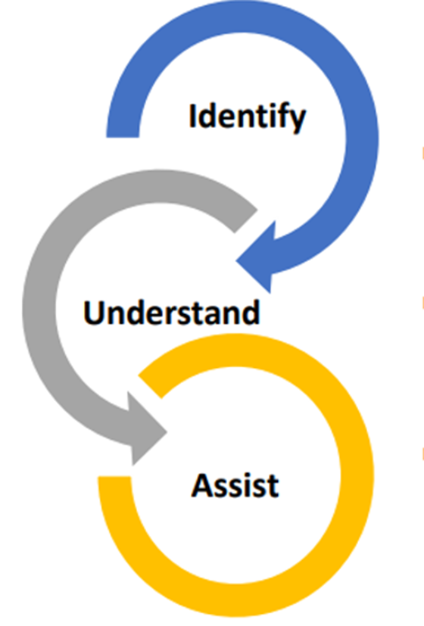
Caring for Caregivers - Key Elements
Identify and record family caregivers in the older adult’s health record in compliance with the Care Act
Understand and assess the needs of the dyad: family caregiver and care recipient utilizing a strengths-based approach
Based on what Matters, work with the family caregiver to identify resources and develop an individualized, person-centered, customized plan
Notes:
Read slide

Slide 11
Identify caregivers
Are you responsible for taking care of a family member or friend with a health condition or disability – helping with their medical care, household needs, shopping, or other help?
Does a family member or friend help you with your medical care, household needs, shopping, or other help?
Include care questions as part of Social Determinants of Health screening
Include care questions as part of your interaction with patients
Include care questions in the Medicare Annual Wellness Visit template

Slide 12
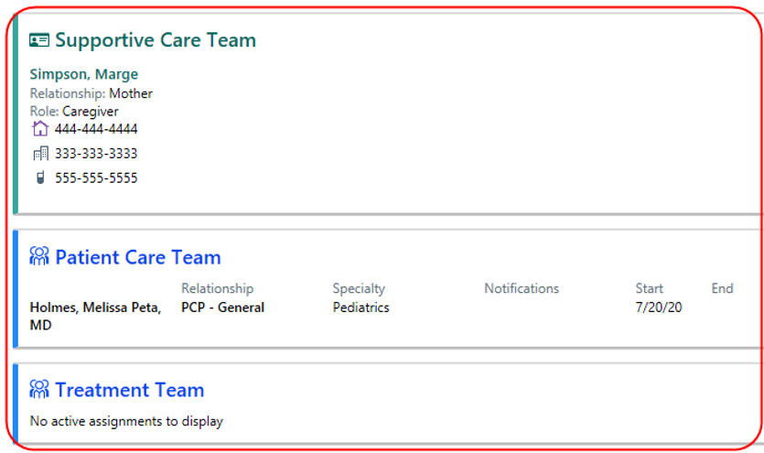
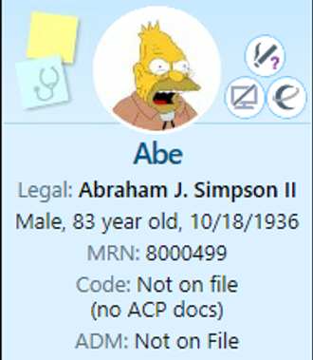


Identifying and Documenting Caregivers
Daughter in Law

Slide 13
Understand caregivers
Social Determinants of Health (SDoH)
Burden Scale for Family Caregivers – Short version
Patient Health Questionnaire-2/9 (PHQ-2/9)
General Anxiety Disorder-2/7 (GAD 2/7)
BRIEF Health Literacy screener
Notes:
Developed at RUSH and now being shared nationally through a grant from The John A. Hartford Foundation and in partnership with the Institute on Healthcare Improvement, the Caring for Caregivers model (C4C) fosters health equity by integrating social care for both the patient and the family caregiver into the health care system and partnering with community agencies to address social determinants of health. The model utilizes a person-centered approach which is tailored to the identified needs of each family caregiver and their care recipient. As such, each individual’s layers of intersectionality and unique situation are assessed and addressed as appropriate within the structure of the intervention. Rooted in the CARE Act (Caregiver, Advise, Respond, Enable) and the 4Ms framework of an Age-Friendly Health System, the Caring for The Caring for Caregivers (C4C) model incorporates evidence-based practices into a single framework to identify, understand, and assist with the social care needs of the dyad.

Slide 14
Understand caregivers
Assessments
Social Determinants of Health (SDoH)
Burden Scale for Family Caregivers – Short version
Patient Health Questionnaire-2/9 (PHQ-2/9)
General Anxiety Disorder-2/7 (GAD 2/7)
BRIEF Health Literacy screener

Slide 15
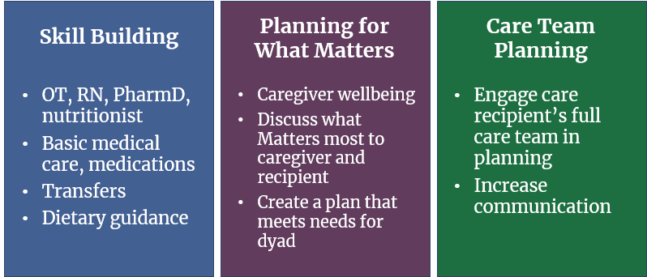
Assist caregivers
Notes:
Referrals to PTs, OTs, pharmacists, dieticians, and social workers to support caregiver well-being and increase confidence in providing care
Brief psychotherapy sessions based on What Matters to the caregiver and care recipient
Care team, caregiver, and care recipient meet to discuss goals of care that incorporate What Matters to the care recipient and caregiver

Slide 16
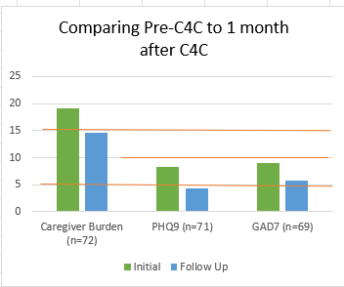
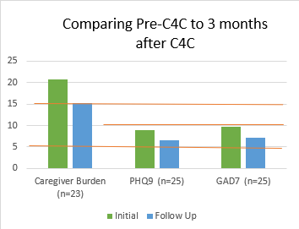
Caregiver data outcomes
Notes:
Once caregivers complete the C4C intervention, we follow up and assess again for burden, depressive symptoms, and anxiety symptoms at 1 month and 3 months – we see reductions in each of these assessed areas at both 1month and 3 months follow up. This also gives us an opportunity to ask if there are any new needs that may need to be addressed.

Slide 17
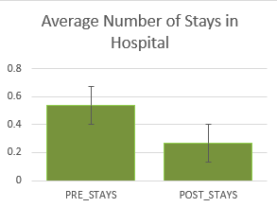
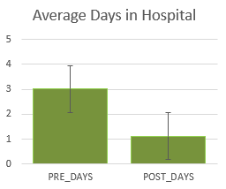
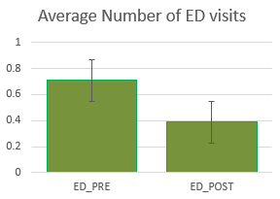
Care recipient data outcomes (n=313)
Outcomes:
Statistically significant results of >50% reductions
Notes:
For those care recipients who received their medical care at Rush, we looked at their utilization of the hospital six months PRIOR to their caregiver receiving our C4C intervention and six months POST C4C intervention. Outcomes – reductions in number of stays in the hospital, reductions in number of days in the hospital, and the number of Emergency Department visits.

Slide 18
Caring for Caregivers – Adaptable + Sustainable
Billing is done through the caregiver’s insurance, not the care recipient’s insurance. The caregiver is your patient/client and the one for whom services are directed and provided.
This means that a chart is opened for each caregiver and includes their insurance information.
Billing for services is done using specific billing codes for both private insurers and CMS insurance plans.

Slide 19
Tipping point
CMS Caregiver Training Service codes
CMS GUIDE model
CMS Age-Friendly Health System Measures

Slide 20
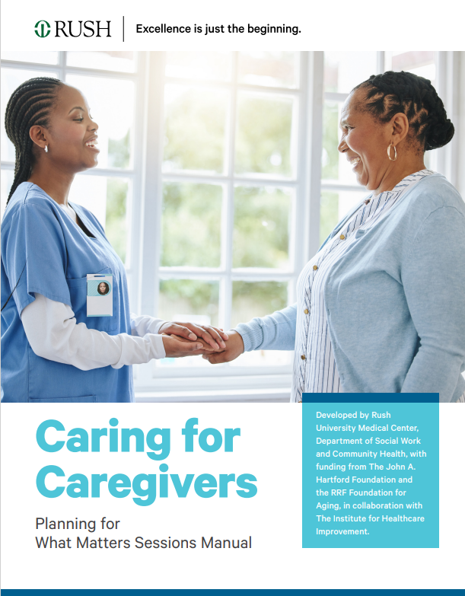
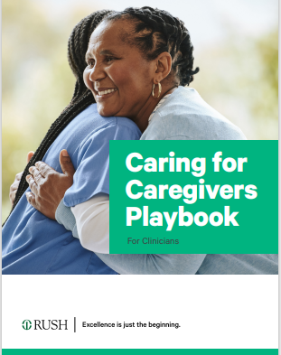
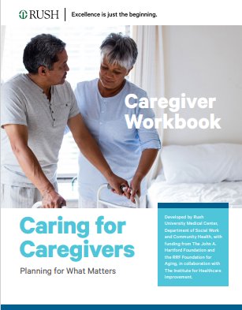
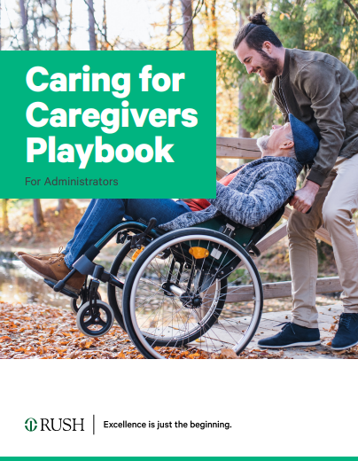
C4C Playbooks
Notes:
Regarding the CMS Age-Friendly Health Measure of caregiver stress: We can not speak to how all Health systems are proceeding, but we have connected with many Age-Friendly Health systems that are still developing their approach and have reached out to RUSH for our process.
It is our understanding that systems are meant to identify the patient's caregiver and screen the patient's caregiver for stress. RUSH is still finalizing their workflow process, and currently this area is being supported through our Caring for Caregivers model.
There are several caregiver stress tools such as the Short Form Zarit Burden Interview (ZBI-12) and the Burden Scale for Family Caregivers-short version. An important additional consideration with this AFHS measure is that if systems are screening for caregiver stress, it is imperative that they then have a plan for assisting the caregiver if stress is indicated. This is not a written requirement of the measure, however it is considered best practice as it is sub-optimal care to screen for something and not address it. Our Caring for Caregivers model supports this best practice.

Slide 21
Sharing Caring for Caregivers Nationwide
Support for Implementation is provided at no cost and Includes:
Training on the C4C model
Educational materials to assist sites with implementation
Technical assistance with adapting the model to your setting, customizing for specific populations and funding streams

Slide 22


For more information: caregivers@rush.edu

